Slide 1


Automated QUBO Generation

Slide 2
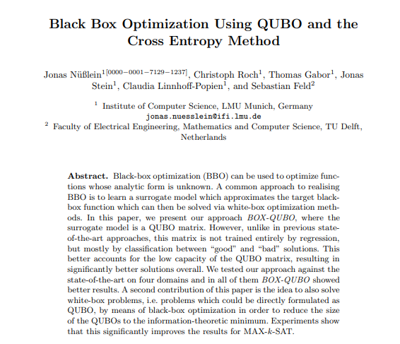
Automated QUBO Generation: BOX-QUBO

Slide 3
What we have seen so far…
Manual, arithmetic QUBO formulations
Semi-automated QUBO formulations: finding patterns using brute force
Algorithmic QUBO formulations: a more expressive way to manually formulate QUBOs

Slide 4
What we have seen so far…
Manual, arithmetic QUBO formulations
Semi-automated QUBO formulations: finding patterns using brute force
Algorithmic QUBO formulations: a more expressive way to manually formulate QUBOs
Now: fully-automated process of creating QUBOs

Slide 5
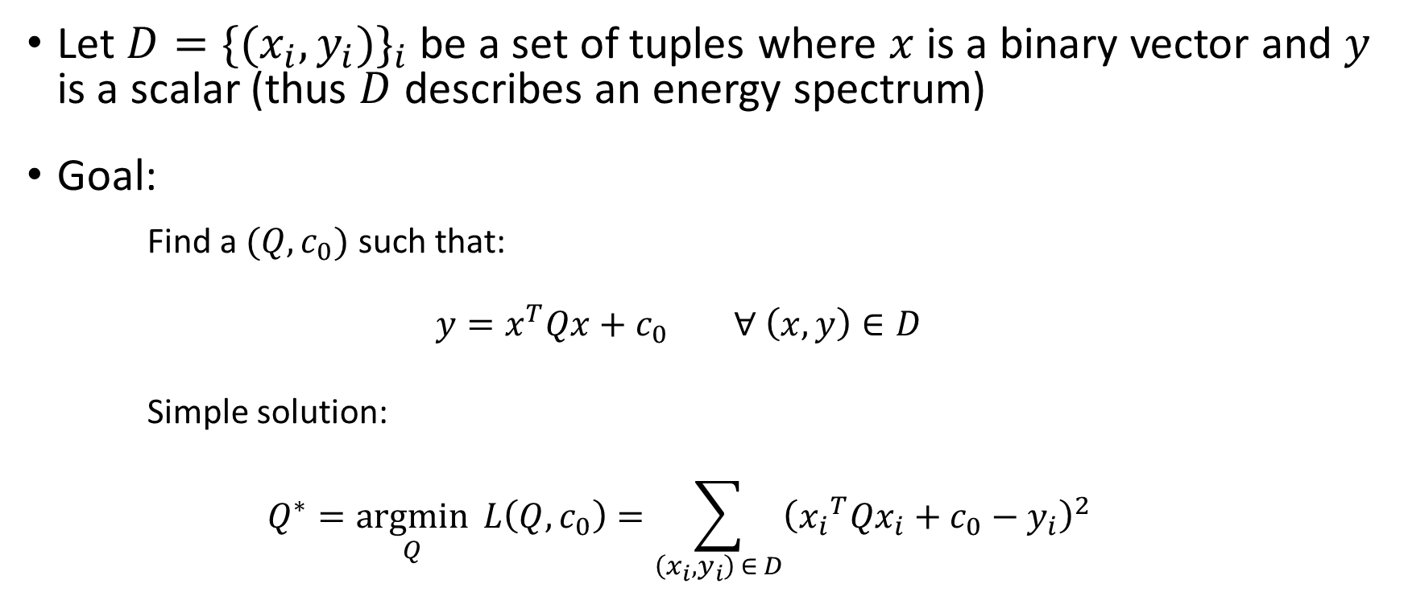
Problem setting
Let $D={\{(x_{i},y_{i})\}}_{i}$ be a set of tuples where $x$ is a binary vector and $y$ is a scalar (thus $D$ describes an energy spectrum)
Goal:
Find a $(Q,c_{0})$ such that:
$$y=x^{T}Qx+c_{0} ∀ \left(x,y\right)∈D$$
Simple solution:
$$Q^{∗}=\underset{Q}{argmin}{ L\left(Q,c_{0}\right)=\sum_{\left(x_{i},y_{i}\right) ∈ D}{{\left({x_{i}}^{T}Qx_{i}+c_{0}−y_{i}\right)}^{2}}}$$

Slide 6
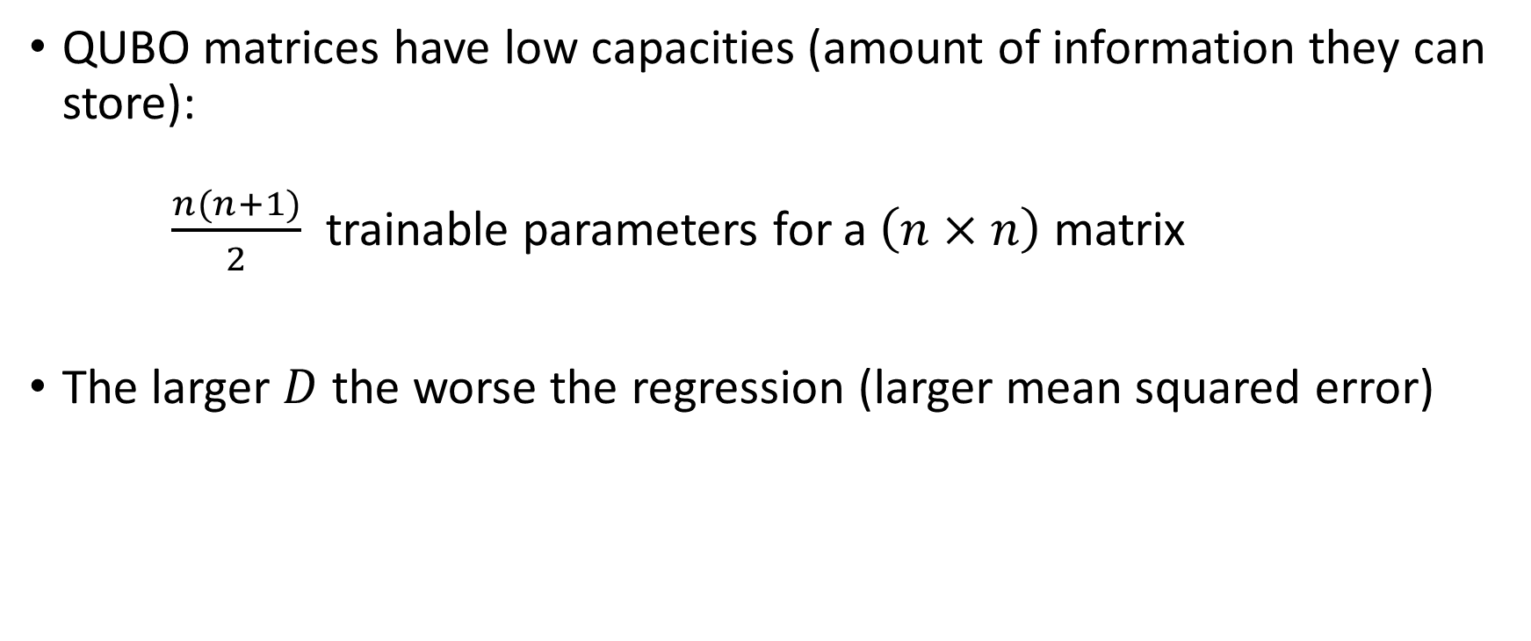
Problem
QUBO matrices have low capacities (amount of information they can store):
$\frac{n(n+1)}{2}$ trainable parameters for a $\left(n×n\right)$ matrix
The larger $D$ the worse the regression (larger mean squared error)

Slide 7
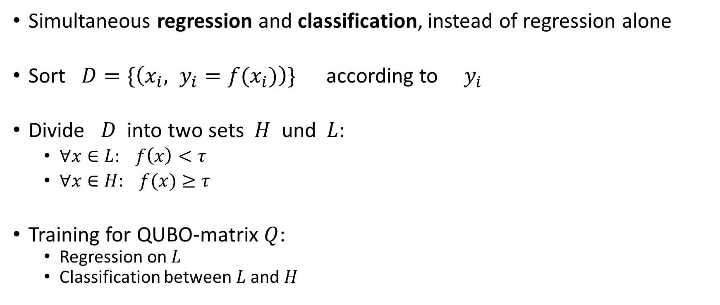
BOX-QUBO - Idea
Simultaneous regression and classification, instead of regression alone
Sort $D=\{\left(x_{i}, y_{i}=f(x_{i})\right)\}$ according to $y_{i}$
Divide $D$ into two sets $H$ und $L$:
$∀x∈L: f\left(x\right)<τ$
$∀x∈H: f(x)≥τ$
Training for QUBO-matrix $Q$:
Regression on $L$
Classification between $L$ and $H$
Effect:
Classification places lower demands on capacity than regression
This makes the remaining regression on 𝐿 more accurate

Slide 8


BOX-QUBO - Idea
$$y=x^{T}Qx+c_{0} ∀ \left(x,y\right)∈D$$
$$y<x^{T}Qx+c_{0} ∀ \left(x,y\right)∈H$$
$$y=x^{T}Qx+c_{0} ∀ \left(x,y\right)∈L$$
$$H∪L=D$$
$$H∩L=∅$$

Slide 9
Example

Slide 10

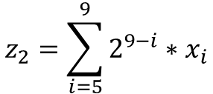
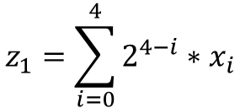

L$et z_{1}$ and $z_{2}$ be two numbers represented using 5 qubits each $→$ value range $[0;31]$
$$z_{1}=\sum_{i=0}^{4}{2^{4−i}∗x_{i}}$$
$$z_{2}=\sum_{i=5}^{9}{2^{9−i}∗x_{i}}$$
0 | 0 | 1 | 1 | 1 | 1 | 0 | 1 | 0 | 0
$$z_{1}=7$$
$$z_{2}=20$$

Slide 11

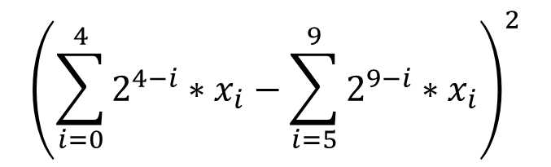
L$et z_{1}$ and $z_{2}$ be two numbers represented using 5 qubits each $→$ value range $[0;31]$
We want to encode
this constraint: $z_{1}−z_{2}=0$
Solution: ${(z_{1}−z_{2})}^{2} =$
256 | 256 | 128 | 64 | 32 | -512 | -256 | -128 | -64 | -32
 | 64 | 64 | 32 | 16 | -256 | -128 | -64 | -32 | -16
 |  | 16 | 16 | 8 | -128 | -64 | -32 | -16 | -8
 |  |  | 4 | 4 | -64 | -32 | -16 | -8 | -4
 |  |  |  | 1 | -32 | -16 | -8 | -4 | -2
 |  |  |  |  | 256 | 256 | 128 | 64 | 32
 |  |  |  |  |  | 64 | 64 | 32 | 16
 |  |  |  |  |  |  | 16 | 16 | 8
 |  |  |  |  |  |  |  | 4 | 4
 |  |  |  |  |  |  |  |  | 1
$${\left(\sum_{i=0}^{4}{2^{4−i}∗x_{i}}−\sum_{i=5}^{9}{2^{9−i}∗x_{i}}\right)}^{2}$$

Slide 12




$$z_{1}=5$$
$$z_{2}=5$$
 | 0 | 0 | 1 | 0 | 1 | 0 | 0 | 1 | 0 | 1
0 | 256 | 256 | 128 | 64 | 32 | -512 | -256 | -128 | -64 | -32
0 |  | 64 | 64 | 32 | 16 | -256 | -128 | -64 | -32 | -16
1 |  |  | 16 | 16 | 8 | -128 | -64 | -32 | -16 | -8
0 |  |  |  | 4 | 4 | -64 | -32 | -16 | -8 | -4
1 |  |  |  |  | 1 | -32 | -16 | -8 | -4 | -2
0 |  |  |  |  |  | 256 | 256 | 128 | 64 | 32
0 |  |  |  |  |  |  | 64 | 64 | 32 | 16
1 |  |  |  |  |  |  |  | 16 | 16 | 8
0 |  |  |  |  |  |  |  |  | 4 | 4
1 |  |  |  |  |  |  |  |  |  | 1
$$z_{1}=5$$
$$z_{2}=5$$

Slide 13
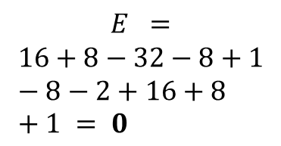
$$z_{1}=5$$
$$z_{2}=5$$
 | 0 | 0 | 1 | 0 | 1 | 0 | 0 | 1 | 0 | 1
0 | 256 | 256 | 128 | 64 | 32 | -512 | -256 | -128 | -64 | -32
0 |  | 64 | 64 | 32 | 16 | -256 | -128 | -64 | -32 | -16
1 |  |  | 16 | 16 | 8 | -128 | -64 | -32 | -16 | -8
0 |  |  |  | 4 | 4 | -64 | -32 | -16 | -8 | -4
1 |  |  |  |  | 1 | -32 | -16 | -8 | -4 | -2
0 |  |  |  |  |  | 256 | 256 | 128 | 64 | 32
0 |  |  |  |  |  |  | 64 | 64 | 32 | 16
1 |  |  |  |  |  |  |  | 16 | 16 | 8
0 |  |  |  |  |  |  |  |  | 4 | 4
1 |  |  |  |  |  |  |  |  |  | 1
$$z_{1}=5$$
$$E =$$
$$16+8−32−8+1−8−2+16+8+1 = 0$$
$$z_{2}=5$$

Slide 14

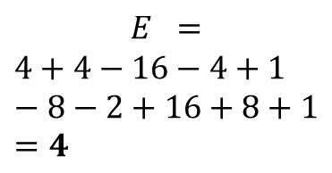

$$z_{1}=3$$
$$z_{2}=5$$
 | 0 | 0 | 0 | 1 | 1 | 0 | 0 | 1 | 0 | 1
0 | 256 | 256 | 128 | 64 | 32 | -512 | -256 | -128 | -64 | -32
0 |  | 64 | 64 | 32 | 16 | -256 | -128 | -64 | -32 | -16
0 |  |  | 16 | 16 | 8 | -128 | -64 | -32 | -16 | -8
1 |  |  |  | 4 | 4 | -64 | -32 | -16 | -8 | -4
1 |  |  |  |  | 1 | -32 | -16 | -8 | -4 | -2
0 |  |  |  |  |  | 256 | 256 | 128 | 64 | 32
0 |  |  |  |  |  |  | 64 | 64 | 32 | 16
1 |  |  |  |  |  |  |  | 16 | 16 | 8
0 |  |  |  |  |  |  |  |  | 4 | 4
1 |  |  |  |  |  |  |  |  |  | 1
$$z_{1}=3$$
$$E =$$
$$4+4−16−4+1−8−2+16+8+1=4$$
$$z_{2}=5$$

Slide 15

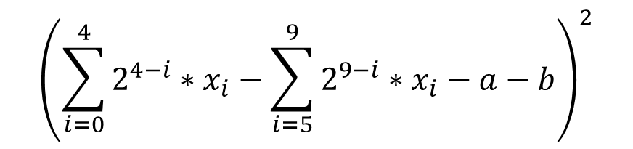
L$et z_{1}$ and $z_{2}$ be two numbers represented using 5 qubits each $→$ value range $[0;31]$
We want to encode
this constraint: $0≤z_{1}−z_{2}≤2$
Solution: ${(z_{1}−z_{2}−a−b)}^{2} =$
256 | 256 | 128 | 64 | 32 | -512 | -256 | -128 | -64 | -32 | -32 | -32
 | 64 | 64 | 32 | 16 | -256 | -128 | -64 | -32 | -16 | -16 | -16
 |  | 16 | 16 | 8 | -128 | -64 | -32 | -16 | -8 | -8 | -8
 |  |  | 4 | 4 | -64 | -32 | -16 | -8 | -4 | -4 | -4
 |  |  |  | 1 | -32 | -16 | -8 | -4 | -2 | -2 | -2
 |  |  |  |  | 256 | 256 | 128 | 64 | 32 | 32 | 32
 |  |  |  |  |  | 64 | 64 | 32 | 16 | 16 | 16
 |  |  |  |  |  |  | 16 | 16 | 8 | 8 | 8
 |  |  |  |  |  |  |  | 4 | 4 | 4 | 4
 |  |  |  |  |  |  |  |  | 1 | 2 | 2
 |  |  |  |  |  |  |  |  |  | 1 | 2
 |  |  |  |  |  |  |  |  |  |  | 1
$${\left(\sum_{i=0}^{4}{2^{4−i}∗x_{i}}−\sum_{i=5}^{9}{2^{9−i}∗x_{i}}−a−b\right)}^{2}$$

Slide 16

$$z_{1}=5$$
$$z_{2}=5$$
 | 0 | 0 | 1 | 0 | 1 | 0 | 0 | 1 | 0 | 1 | 0 | 0
0 | 256 | 256 | 128 | 64 | 32 | -512 | -256 | -128 | -64 | -32 | -32 | -32
0 |  | 64 | 64 | 32 | 16 | -256 | -128 | -64 | -32 | -16 | -16 | -16
1 |  |  | 16 | 16 | 8 | -128 | -64 | -32 | -16 | -8 | -8 | -8
0 |  |  |  | 4 | 4 | -64 | -32 | -16 | -8 | -4 | -4 | -4
1 |  |  |  |  | 1 | -32 | -16 | -8 | -4 | -2 | -2 | -2
0 |  |  |  |  |  | 256 | 256 | 128 | 64 | 32 | 32 | 32
0 |  |  |  |  |  |  | 64 | 64 | 32 | 16 | 16 | 16
1 |  |  |  |  |  |  |  | 16 | 16 | 8 | 8 | 8
0 |  |  |  |  |  |  |  |  | 4 | 4 | 4 | 4
1 |  |  |  |  |  |  |  |  |  | 1 | 2 | 2
0 |  |  |  |  |  |  |  |  |  |  | 1 | 2
0 |  |  |  |  |  |  |  |  |  |  |  | 1
$$z_{1}=5$$
$$E=0$$
$$z_{2}=5$$

Slide 17


$$z_{1}=6$$
$$z_{2}=5$$
 | 0 | 0 | 1 | 1 | 0 | 0 | 0 | 1 | 0 | 1 | 0 | 1
0 | 256 | 256 | 128 | 64 | 32 | -512 | -256 | -128 | -64 | -32 | -32 | -32
0 |  | 64 | 64 | 32 | 16 | -256 | -128 | -64 | -32 | -16 | -16 | -16
1 |  |  | 16 | 16 | 8 | -128 | -64 | -32 | -16 | -8 | -8 | -8
1 |  |  |  | 4 | 4 | -64 | -32 | -16 | -8 | -4 | -4 | -4
0 |  |  |  |  | 1 | -32 | -16 | -8 | -4 | -2 | -2 | -2
0 |  |  |  |  |  | 256 | 256 | 128 | 64 | 32 | 32 | 32
0 |  |  |  |  |  |  | 64 | 64 | 32 | 16 | 16 | 16
1 |  |  |  |  |  |  |  | 16 | 16 | 8 | 8 | 8
0 |  |  |  |  |  |  |  |  | 4 | 4 | 4 | 4
1 |  |  |  |  |  |  |  |  |  | 1 | 2 | 2
0 |  |  |  |  |  |  |  |  |  |  | 1 | 2
1 |  |  |  |  |  |  |  |  |  |  |  | 1
$z_{1}=$6
$$E=0$$
$$z_{2}=5$$

Slide 18


$$z_{1}=7$$
$$z_{2}=5$$
 | 0 | 0 | 1 | 1 | 1 | 0 | 0 | 1 | 0 | 1 | 1 | 1
0 | 256 | 256 | 128 | 64 | 32 | -512 | -256 | -128 | -64 | -32 | -32 | -32
0 |  | 64 | 64 | 32 | 16 | -256 | -128 | -64 | -32 | -16 | -16 | -16
1 |  |  | 16 | 16 | 8 | -128 | -64 | -32 | -16 | -8 | -8 | -8
1 |  |  |  | 4 | 4 | -64 | -32 | -16 | -8 | -4 | -4 | -4
1 |  |  |  |  | 1 | -32 | -16 | -8 | -4 | -2 | -2 | -2
0 |  |  |  |  |  | 256 | 256 | 128 | 64 | 32 | 32 | 32
0 |  |  |  |  |  |  | 64 | 64 | 32 | 16 | 16 | 16
1 |  |  |  |  |  |  |  | 16 | 16 | 8 | 8 | 8
0 |  |  |  |  |  |  |  |  | 4 | 4 | 4 | 4
1 |  |  |  |  |  |  |  |  |  | 1 | 2 | 2
1 |  |  |  |  |  |  |  |  |  |  | 1 | 2
1 |  |  |  |  |  |  |  |  |  |  |  | 1
$$z_{1}=7$$
$$E=0$$
$$z_{2}=5$$

Slide 19



$$z_{1}=8$$
$$z_{2}=5$$
 | 0 | 1 | 0 | 0 | 0 | 0 | 0 | 1 | 0 | 1 | 1 | 1
0 | 256 | 256 | 128 | 64 | 32 | -512 | -256 | -128 | -64 | -32 | -32 | -32
1 |  | 64 | 64 | 32 | 16 | -256 | -128 | -64 | -32 | -16 | -16 | -16
0 |  |  | 16 | 16 | 8 | -128 | -64 | -32 | -16 | -8 | -8 | -8
0 |  |  |  | 4 | 4 | -64 | -32 | -16 | -8 | -4 | -4 | -4
0 |  |  |  |  | 1 | -32 | -16 | -8 | -4 | -2 | -2 | -2
0 |  |  |  |  |  | 256 | 256 | 128 | 64 | 32 | 32 | 32
0 |  |  |  |  |  |  | 64 | 64 | 32 | 16 | 16 | 16
1 |  |  |  |  |  |  |  | 16 | 16 | 8 | 8 | 8
0 |  |  |  |  |  |  |  |  | 4 | 4 | 4 | 4
1 |  |  |  |  |  |  |  |  |  | 1 | 2 | 2
1 |  |  |  |  |  |  |  |  |  |  | 1 | 2
1 |  |  |  |  |  |  |  |  |  |  |  | 1
$$z_{1}=8$$
$$E=1>0$$
$$z_{2}=5$$

Slide 20





$$z_{1}=2$$
$$z_{2}=29$$
 | 0 | 0 | 0 | 1 | 0 | 1 | 1 | 0 | 1 | 1 | 0 | 0
0 | 256 | 256 | 128 | 64 | 32 | -512 | -256 | -128 | -64 | -32 | -32 | -32
0 |  | 64 | 64 | 32 | 16 | -256 | -128 | -64 | -32 | -16 | -16 | -16
0 |  |  | 16 | 16 | 8 | -128 | -64 | -32 | -16 | -8 | -8 | -8
1 |  |  |  | 4 | 4 | -64 | -32 | -16 | -8 | -4 | -4 | -4
0 |  |  |  |  | 1 | -32 | -16 | -8 | -4 | -2 | -2 | -2
1 |  |  |  |  |  | 256 | 256 | 128 | 64 | 32 | 32 | 32
1 |  |  |  |  |  |  | 64 | 64 | 32 | 16 | 16 | 16
0 |  |  |  |  |  |  |  | 16 | 16 | 8 | 8 | 8
1 |  |  |  |  |  |  |  |  | 4 | 4 | 4 | 4
1 |  |  |  |  |  |  |  |  |  | 1 | 2 | 2
0 |  |  |  |  |  |  |  |  |  |  | 1 | 2
0 |  |  |  |  |  |  |  |  |  |  |  | 1
$$z_{1}=2$$
$$E=729>0$$
$$z_{2}=29$$

Slide 21

Now: using BOX-QUBO we can find a QUBO which encodes the constraint $0≤z_{1}−z_{2}≤2$ without the ancilla qubits

Slide 22

Constraint ${0≤z}_{1}−z_{2}≤2$ as QUBO:
Hand-designed Encoding
Encoding learned with BOX-QUBO
256 | 256 | 128 | 64 | 32 | -512 | -256 | -128 | -64 | -32 | -32 | -32
 | 64 | 64 | 32 | 16 | -256 | -128 | -64 | -32 | -16 | -16 | -16
 |  | 16 | 16 | 8 | -128 | -64 | -32 | -16 | -8 | -8 | -8
 |  |  | 4 | 4 | -64 | -32 | -16 | -8 | -4 | -4 | -4
 |  |  |  | 1 | -32 | -16 | -8 | -4 | -2 | -2 | -2
 |  |  |  |  | 256 | 256 | 128 | 64 | 32 | 32 | 32
 |  |  |  |  |  | 64 | 64 | 32 | 16 | 16 | 16
 |  |  |  |  |  |  | 16 | 16 | 8 | 8 | 8
 |  |  |  |  |  |  |  | 4 | 4 | 4 | 4
 |  |  |  |  |  |  |  |  | 1 | 2 | 2
 |  |  |  |  |  |  |  |  |  | 1 | 2
 |  |  |  |  |  |  |  |  |  |  | 1
35 | 43 | 26 | 16 | 8 | -86 | -43 | -26 | -16 | -8
 | 9 | 13 | 8 | 4 | -43 | -26 | -13 | -8 | -4
 |  | 2 | 4 | 2 | -26 | -13 | -8 | -4 | -2
 |  |  | 0 | 1 | -16 | -8 | -4 | -2 | -1
 |  |  |  | 0 | -8 | -4 | -2 | -1 | -1
 |  |  |  |  | 51 | 43 | 26 | 16 | 8
 |  |  |  |  |  | 17 | 13 | 8 | 4
 |  |  |  |  |  |  | 6 | 4 | 2
 |  |  |  |  |  |  |  | 2 | 1
 |  |  |  |  |  |  |  |  | 1

Slide 23
Constraint ${0≤z}_{1}−z_{2}≤2$ as QUBO:
Hand-designed Encoding
Encoding learned with BOX-QUBO
256 | 256 | 128 | 64 | 32 | -512 | -256 | -128 | -64 | -32 | -32 | -32
 | 64 | 64 | 32 | 16 | -256 | -128 | -64 | -32 | -16 | -16 | -16
 |  | 16 | 16 | 8 | -128 | -64 | -32 | -16 | -8 | -8 | -8
 |  |  | 4 | 4 | -64 | -32 | -16 | -8 | -4 | -4 | -4
 |  |  |  | 1 | -32 | -16 | -8 | -4 | -2 | -2 | -2
 |  |  |  |  | 256 | 256 | 128 | 64 | 32 | 32 | 32
 |  |  |  |  |  | 64 | 64 | 32 | 16 | 16 | 16
 |  |  |  |  |  |  | 16 | 16 | 8 | 8 | 8
 |  |  |  |  |  |  |  | 4 | 4 | 4 | 4
 |  |  |  |  |  |  |  |  | 1 | 2 | 2
 |  |  |  |  |  |  |  |  |  | 1 | 2
 |  |  |  |  |  |  |  |  |  |  | 1
35 | 43 | 26 | 16 | 8 | -86 | -43 | -26 | -16 | -8
 | 9 | 13 | 8 | 4 | -43 | -26 | -13 | -8 | -4
 |  | 2 | 4 | 2 | -26 | -13 | -8 | -4 | -2
 |  |  | 0 | 1 | -16 | -8 | -4 | -2 | -1
 |  |  |  | 0 | -8 | -4 | -2 | -1 | -1
 |  |  |  |  | 51 | 43 | 26 | 16 | 8
 |  |  |  |  |  | 17 | 13 | 8 | 4
 |  |  |  |  |  |  | 6 | 4 | 2
 |  |  |  |  |  |  |  | 2 | 1
 |  |  |  |  |  |  |  |  | 1
Fewer qubits and smaller values

Slide 24

Constraint ${0≤z}_{1}−z_{2}≤2$ as QUBO:
Hand-designed Encoding
Encoding learned with BOX-QUBO
256 | 256 | 128 | 64 | 32 | -512 | -256 | -128 | -64 | -32 | -32 | -32
 | 64 | 64 | 32 | 16 | -256 | -128 | -64 | -32 | -16 | -16 | -16
 |  | 16 | 16 | 8 | -128 | -64 | -32 | -16 | -8 | -8 | -8
 |  |  | 4 | 4 | -64 | -32 | -16 | -8 | -4 | -4 | -4
 |  |  |  | 1 | -32 | -16 | -8 | -4 | -2 | -2 | -2
 |  |  |  |  | 256 | 256 | 128 | 64 | 32 | 32 | 32
 |  |  |  |  |  | 64 | 64 | 32 | 16 | 16 | 16
 |  |  |  |  |  |  | 16 | 16 | 8 | 8 | 8
 |  |  |  |  |  |  |  | 4 | 4 | 4 | 4
 |  |  |  |  |  |  |  |  | 1 | 2 | 2
 |  |  |  |  |  |  |  |  |  | 1 | 2
 |  |  |  |  |  |  |  |  |  |  | 1
35 | 43 | 26 | 16 | 8 | -86 | -43 | -26 | -16 | -8
 | 9 | 13 | 8 | 4 | -43 | -26 | -13 | -8 | -4
 |  | 2 | 4 | 2 | -26 | -13 | -8 | -4 | -2
 |  |  | 0 | 1 | -16 | -8 | -4 | -2 | -1
 |  |  |  | 0 | -8 | -4 | -2 | -1 | -1
 |  |  |  |  | 51 | 43 | 26 | 16 | 8
 |  |  |  |  |  | 17 | 13 | 8 | 4
 |  |  |  |  |  |  | 6 | 4 | 2
 |  |  |  |  |  |  |  | 2 | 1
 |  |  |  |  |  |  |  |  | 1
Fewer qubits and smaller values

Slide 25

$$z_{1}=5$$
$$z_{2}=5$$
 | 0 | 0 | 1 | 0 | 1 | 0 | 0 | 1 | 0 | 1
0 | 35 | 43 | 26 | 16 | 8 | -86 | -43 | -26 | -16 | -8
0 |  | 9 | 13 | 8 | 4 | -43 | -26 | -13 | -8 | -4
1 |  |  | 2 | 4 | 2 | -26 | -13 | -8 | -4 | -2
0 |  |  |  | 0 | 1 | -16 | -8 | -4 | -2 | -1
1 |  |  |  |  | 0 | -8 | -4 | -2 | -1 | -1
0 |  |  |  |  |  | 51 | 43 | 26 | 16 | 8
0 |  |  |  |  |  |  | 17 | 13 | 8 | 4
1 |  |  |  |  |  |  |  | 6 | 4 | 2
0 |  |  |  |  |  |  |  |  | 2 | 1
1 |  |  |  |  |  |  |  |  |  | 1
$$z_{1}=5$$
$$E=0$$
$$z_{2}=5$$

Slide 26
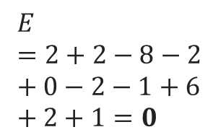
$$z_{1}=5$$
$$z_{2}=5$$
 | 0 | 0 | 1 | 0 | 1 | 0 | 0 | 1 | 0 | 1
0 | 35 | 43 | 26 | 16 | 8 | -86 | -43 | -26 | -16 | -8
0 |  | 9 | 13 | 8 | 4 | -43 | -26 | -13 | -8 | -4
1 |  |  | 2 | 4 | 2 | -26 | -13 | -8 | -4 | -2
0 |  |  |  | 0 | 1 | -16 | -8 | -4 | -2 | -1
1 |  |  |  |  | 0 | -8 | -4 | -2 | -1 | -1
0 |  |  |  |  |  | 51 | 43 | 26 | 16 | 8
0 |  |  |  |  |  |  | 17 | 13 | 8 | 4
1 |  |  |  |  |  |  |  | 6 | 4 | 2
0 |  |  |  |  |  |  |  |  | 2 | 1
1 |  |  |  |  |  |  |  |  |  | 1
$$z_{1}=5$$
$$E=2+2−8−2+0−2−1+6+2+1=0$$
$$z_{2}=5$$

Slide 27
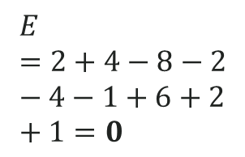

$$z_{1}=6$$
$$z_{2}=5$$
 | 0 | 0 | 1 | 1 | 0 | 0 | 0 | 1 | 0 | 1
0 | 35 | 43 | 26 | 16 | 8 | -86 | -43 | -26 | -16 | -8
0 |  | 9 | 13 | 8 | 4 | -43 | -26 | -13 | -8 | -4
1 |  |  | 2 | 4 | 2 | -26 | -13 | -8 | -4 | -2
1 |  |  |  | 0 | 1 | -16 | -8 | -4 | -2 | -1
0 |  |  |  |  | 0 | -8 | -4 | -2 | -1 | -1
0 |  |  |  |  |  | 51 | 43 | 26 | 16 | 8
0 |  |  |  |  |  |  | 17 | 13 | 8 | 4
1 |  |  |  |  |  |  |  | 6 | 4 | 2
0 |  |  |  |  |  |  |  |  | 2 | 1
1 |  |  |  |  |  |  |  |  |  | 1
$z_{1}=$ 6
$$E=2+4−8−2−4−1+6+2+1=0$$
$$z_{2}=5$$

Slide 28
$$z_{1}=7$$
$$z_{2}=5$$
 | 0 | 0 | 1 | 1 | 1 | 0 | 0 | 1 | 0 | 1
0 | 35 | 43 | 26 | 16 | 8 | -86 | -43 | -26 | -16 | -8
0 |  | 9 | 13 | 8 | 4 | -43 | -26 | -13 | -8 | -4
1 |  |  | 2 | 4 | 2 | -26 | -13 | -8 | -4 | -2
1 |  |  |  | 0 | 1 | -16 | -8 | -4 | -2 | -1
1 |  |  |  |  | 0 | -8 | -4 | -2 | -1 | -1
0 |  |  |  |  |  | 51 | 43 | 26 | 16 | 8
0 |  |  |  |  |  |  | 17 | 13 | 8 | 4
1 |  |  |  |  |  |  |  | 6 | 4 | 2
0 |  |  |  |  |  |  |  |  | 2 | 1
1 |  |  |  |  |  |  |  |  |  | 1
$$z_{1}=7$$
$$E=0$$
$$z_{2}=5$$

Slide 29


$$z_{1}=8$$
$$z_{2}=5$$
 | 0 | 1 | 0 | 0 | 0 | 0 | 0 | 1 | 0 | 1
0 | 35 | 43 | 26 | 16 | 8 | -86 | -43 | -26 | -16 | -8
1 |  | 9 | 13 | 8 | 4 | -43 | -26 | -13 | -8 | -4
0 |  |  | 2 | 4 | 2 | -26 | -13 | -8 | -4 | -2
0 |  |  |  | 0 | 1 | -16 | -8 | -4 | -2 | -1
0 |  |  |  |  | 0 | -8 | -4 | -2 | -1 | -1
0 |  |  |  |  |  | 51 | 43 | 26 | 16 | 8
0 |  |  |  |  |  |  | 17 | 13 | 8 | 4
1 |  |  |  |  |  |  |  | 6 | 4 | 2
0 |  |  |  |  |  |  |  |  | 2 | 1
1 |  |  |  |  |  |  |  |  |  | 1
$z_{1}=$ 8
$$E=1>0$$
$$z_{2}=5$$

Slide 30


$$z_{1}=3$$
$$z_{2}=1$$
 | 0 | 0 | 0 | 1 | 1 | 0 | 0 | 0 | 0 | 1
0 | 35 | 43 | 26 | 16 | 8 | -86 | -43 | -26 | -16 | -8
0 |  | 9 | 13 | 8 | 4 | -43 | -26 | -13 | -8 | -4
0 |  |  | 2 | 4 | 2 | -26 | -13 | -8 | -4 | -2
1 |  |  |  | 0 | 1 | -16 | -8 | -4 | -2 | -1
1 |  |  |  |  | 0 | -8 | -4 | -2 | -1 | -1
0 |  |  |  |  |  | 51 | 43 | 26 | 16 | 8
0 |  |  |  |  |  |  | 17 | 13 | 8 | 4
0 |  |  |  |  |  |  |  | 6 | 4 | 2
0 |  |  |  |  |  |  |  |  | 2 | 1
1 |  |  |  |  |  |  |  |  |  | 1
$$z_{1}=3$$
$$E=0$$
$$z_{2}=1$$

Slide 31



$$z_{1}=17$$
$$z_{2}=1$$
 | 1 | 0 | 0 | 0 | 1 | 0 | 0 | 0 | 0 | 1
1 | 35 | 43 | 26 | 16 | 8 | -86 | -43 | -26 | -16 | -8
0 |  | 9 | 13 | 8 | 4 | -43 | -26 | -13 | -8 | -4
0 |  |  | 2 | 4 | 2 | -26 | -13 | -8 | -4 | -2
0 |  |  |  | 0 | 1 | -16 | -8 | -4 | -2 | -1
1 |  |  |  |  | 0 | -8 | -4 | -2 | -1 | -1
0 |  |  |  |  |  | 51 | 43 | 26 | 16 | 8
0 |  |  |  |  |  |  | 17 | 13 | 8 | 4
0 |  |  |  |  |  |  |  | 6 | 4 | 2
0 |  |  |  |  |  |  |  |  | 2 | 1
1 |  |  |  |  |  |  |  |  |  | 1
$$z_{1}=17$$
$$E=35>0$$
$$z_{2}=1$$

Slide 32
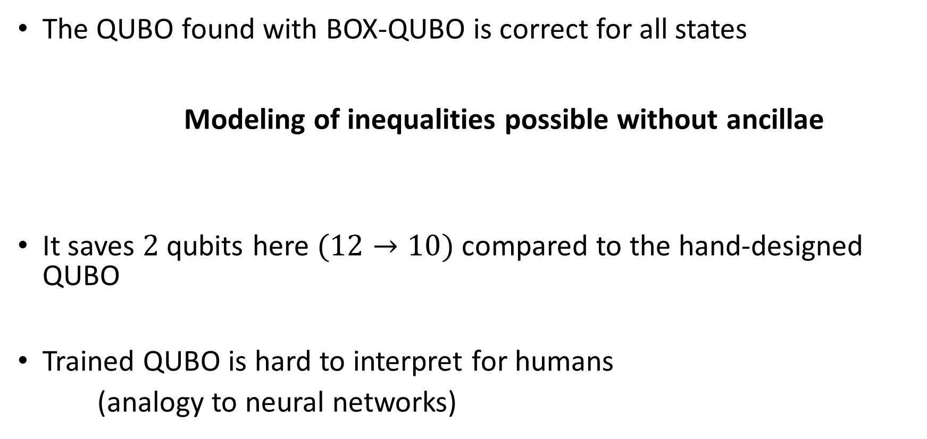
The QUBO found with BOX-QUBO is correct for all states
Modeling of inequalities possible without ancillae
It saves $2$ qubits here $(12→10)$ compared to the hand-designed QUBO
Trained QUBO is hard to interpret for humans
(analogy to neural networks)

Slide 33

Let's get into the code ...

Slide 34
Black-Box Optimization using QUBO

Slide 35
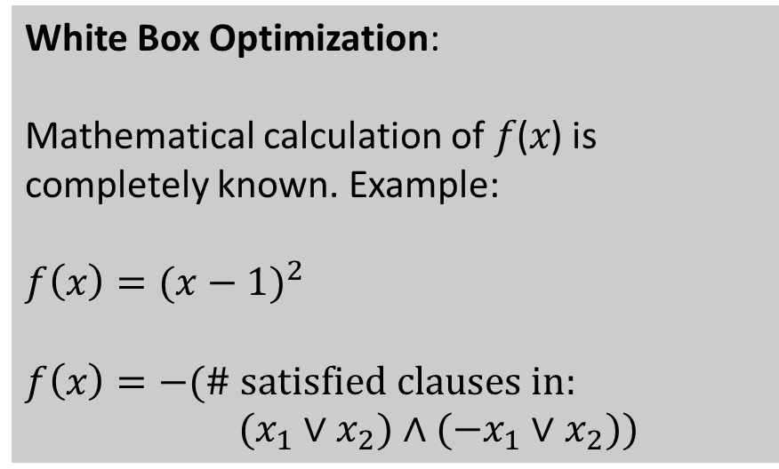

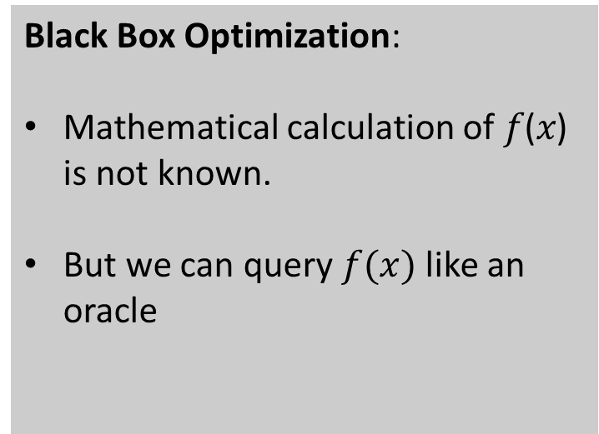
White Box vs. Black Box Optimization
Optimization: $x^{∗}=\underset{x}{argmin}{f(x)}$
White Box Optimization:
Mathematical calculation of 𝑓(𝑥) is completely known. Example:
$$f\left(x\right)={(x−1)}^{2}$$
$$f\left(x\right)=−(\# satisfied clauses in:$$
$(x_{1}∨x_{2})∧(−x_{1}∨x_{2}))$
Black Box Optimization:
Mathematical calculation of 𝑓(𝑥) is not known.
But we can query $f(x)$ like an oracle

Slide 36
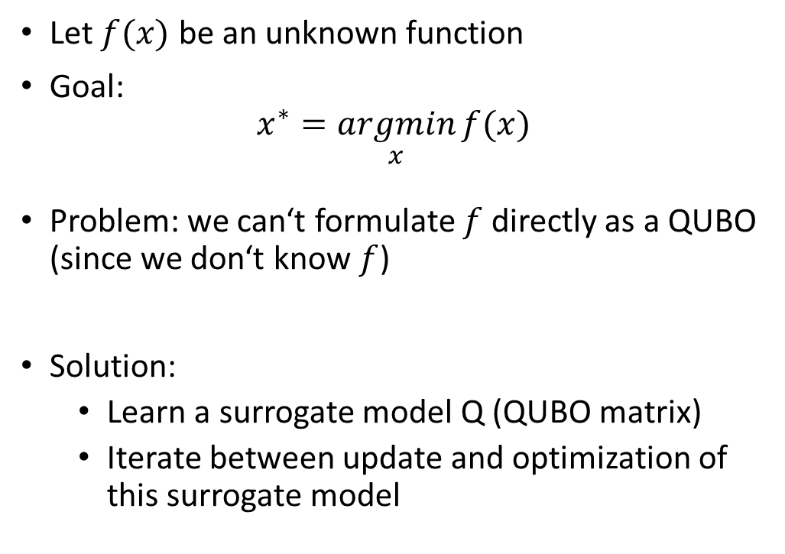
Black-Box Optimization using QUBO
Let$f(x)$ be an unknown function
Goal:
$$x^{∗}=\underset{x}{argmin}{f(x)}$$
Problem: we can‘t formulate $f$directly as a QUBO (since we don‘t know $f$)
Solution:
Learn a surrogate model Q (QUBO matrix)
Iterate between update and optimization of this surrogate model
update Q using (x*, y*=f(x*))
sample x*

Slide 37
Advantages of BBO for QUBO
Easy application: just define the oracle (no knowledge needed about how to encode an objective as a QUBO)
Smaller QUBO sizes. E.g.: in our 3-SAT example (V=15, C=100)
SOTA: 115 logical qubits (for each variable + for each clause)
BBO: 15 logical qubits (for each variable)

Slide 38
Let's get into the code ...

